Slide 1
SMART HOME GOOGLE ASSISTANT WITH PI project by: micheal meghana vasavi saahithya

Slide 2

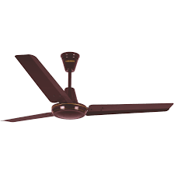
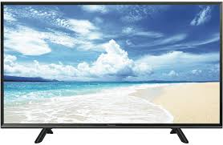

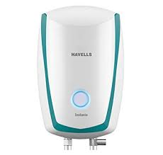
WHAT ? Controlling home appliances using voice command . Such as: Turn on the light Turn off the light Turn on the geyser Turn off the geyser e.t.c.

Slide 3
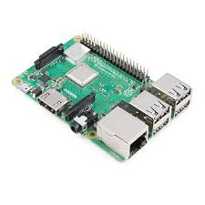

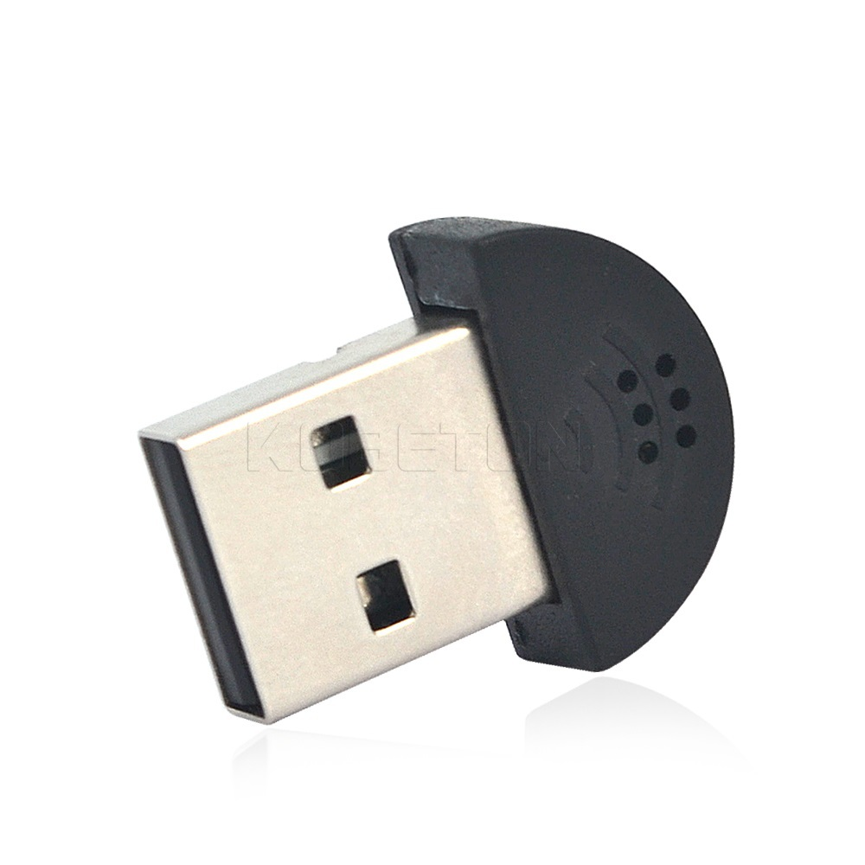
HARDWARE REQUIREMENTS: Raspberry pi SD card Ethernet cable USB microphone Speakers

Slide 4

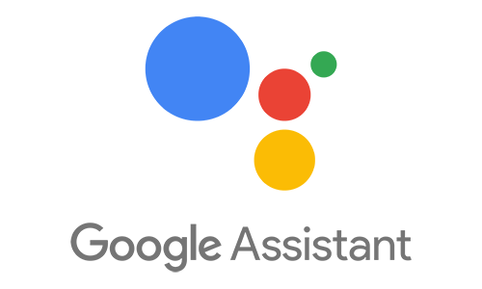
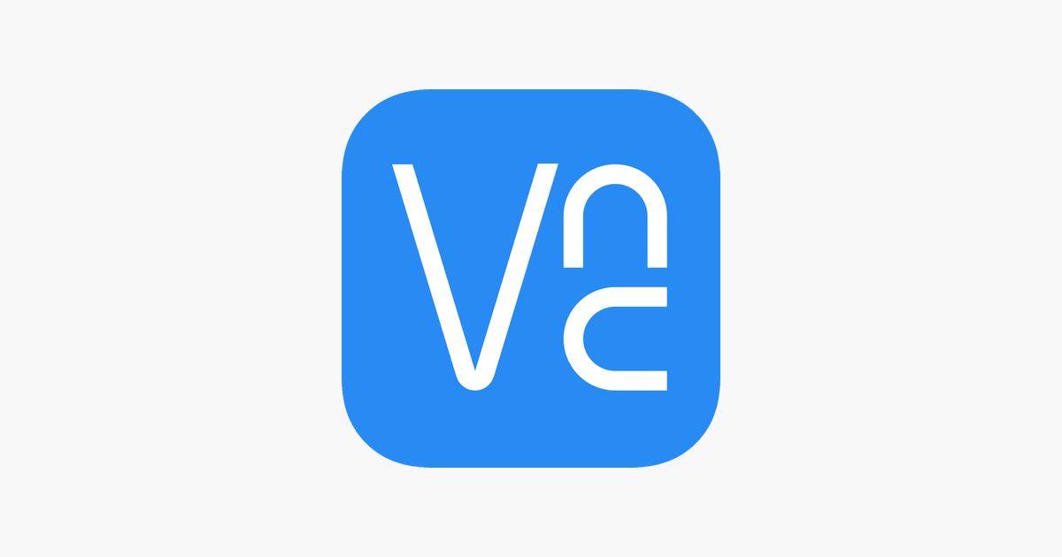
SOFTWARE REQUIREMENTS: Latest raspbian stretch OS VNC viewer Google account Dialogflow

Slide 5


HOW? By installing google assistant in rapspberry pi CUSTOMIZING: Training new voice commands to google assistant using dialogflow

Slide 6

WHY? Future scope To reduce human efforts Home automation User friendly

Slide 7

THANK
YOU

